Slide 1
The Rent is Too
Damn High
Group Members: Syscily Brown, Hailey Bugbee,
Tim McCabe, Brian Walker

Slide 2
The “Why” | The “How” | The “What”
What factors most impact affordability in the US? | What relationship, if any, exists between increasing rent prices and population size? What relationship, if any, exists between increasing rent prices and income? What relationship, if any, exists between increasing rent prices, location, and income How have rent prices and affordability changed relative to poverty rate and unemployment over time? | More densely populated areas seemed to have an increase in both income and cost of living.
Notes:
2 minutes

Slide 3
Data Cleanup & Exploration
Describe the exploration and cleanup process: We started by thinking about the scale of our projects. Did we want to look at one specific city or state? We eventually decided to look at this information on a national level using the US Census API.
Discuss insights you had while exploring the data that you didn't anticipate: We noticed that the US Census API really difficult to use because the columns names are not named in a friendly way.
Discuss any problems that arose after exploring the data, and how you resolved them:
Present and discuss interesting figures developed during exploration, ideally with the help of Jupyter Notebook
Notes:
1 minute

Slide 4
A look at the data...
Notes:
6 minutes -

Slide 5
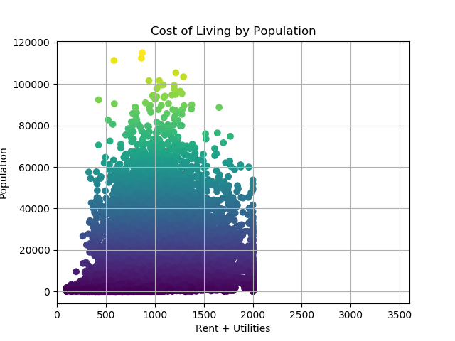
Cost of Living & Total Population 2011
This is a visual representation of the relationship between Median Cost of Living and total Population
Darker colors = lower population lighter colors = higher population

Slide 6
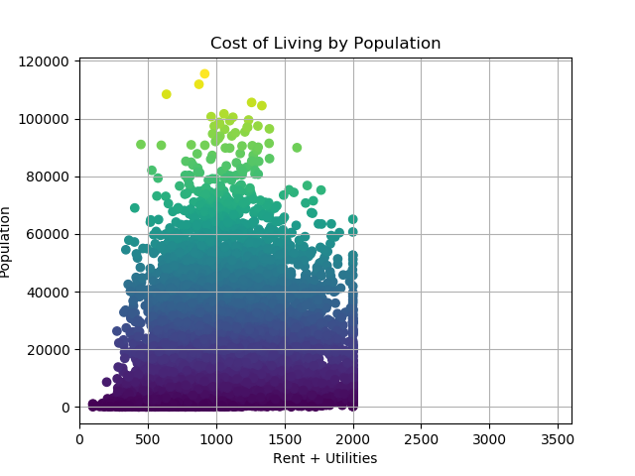
Cost of Living & Total Population 2012
This is a visual representation of the relationship between Median Cost of Living and total Population
Darker colors = lower population lighter colors = higher population

Slide 7
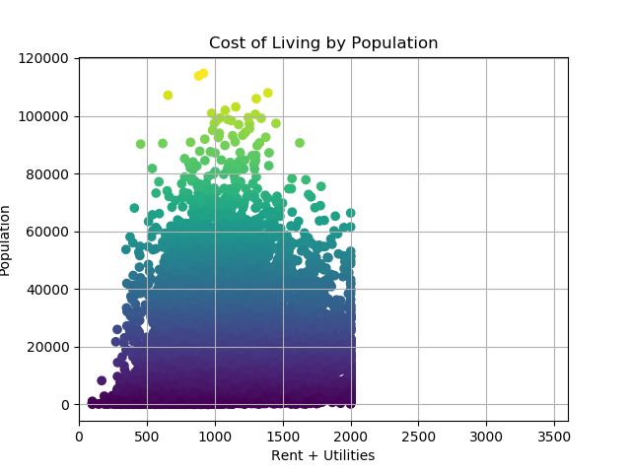
Cost of Living & Total Population 2013
This is a visual representation of the relationship between Median Cost of Living and total Population
Darker colors = lower population lighter colors = higher population

Slide 8
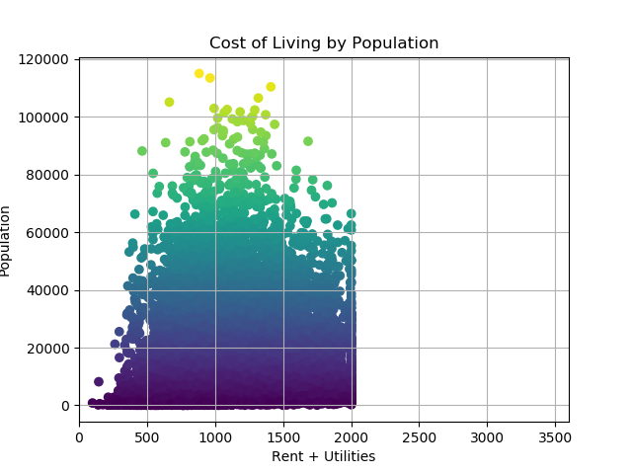
Cost of Living & Total Population 2014
This is a visual representation of the relationship between Median Cost of Living and total Population
Darker colors = lower population lighter colors = higher population

Slide 9
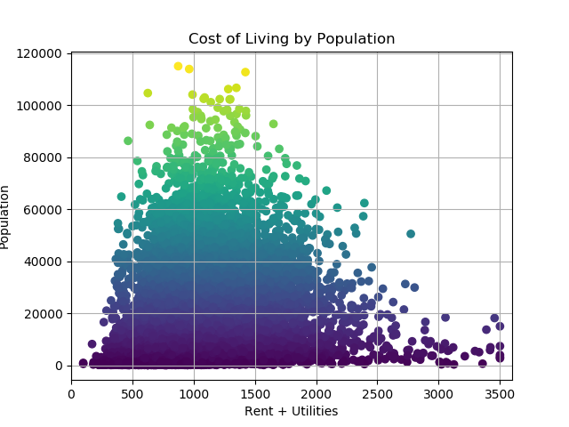
Cost of Living & Total Population 2015
This is a visual representation of the relationship between Median Cost of Living and total Population
Darker colors = lower population lighter colors = higher population
The US Census data shows a maximum median rent of $2,001 for each year except 2015 - which shows a maximum of $3,501.
Notes:
Discuss your findings. Did you find what you expected to find? If not, why not? What inferences or general conclusions can you draw from your analysis?

Slide 10
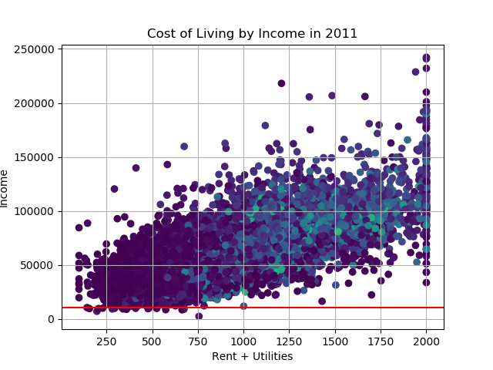
Rent vs. Income 2011
---- = poverty line
= higher population
= lower population
Poverty line = $10,890

Slide 11
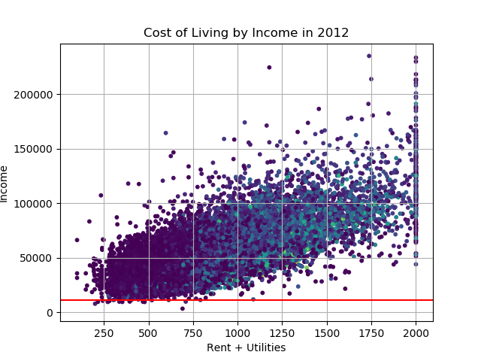
Rent vs. Income 2012
---- = poverty line
= higher population
= lower population
Poverty line = $11,170

Slide 12
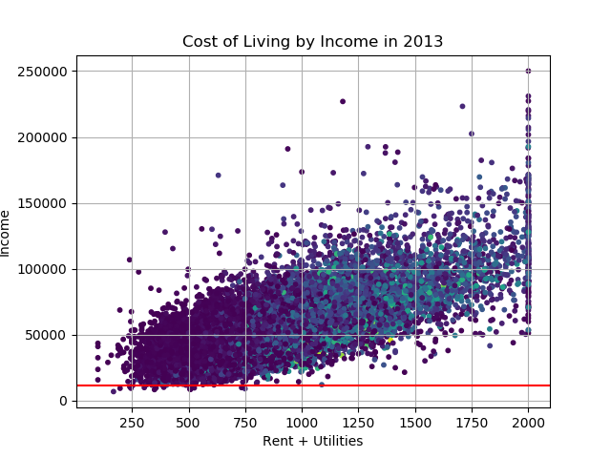
Rent vs. Income 2013
---- = poverty line
= more densely populated
= less densely populated
Poverty line = $11,490

Slide 13
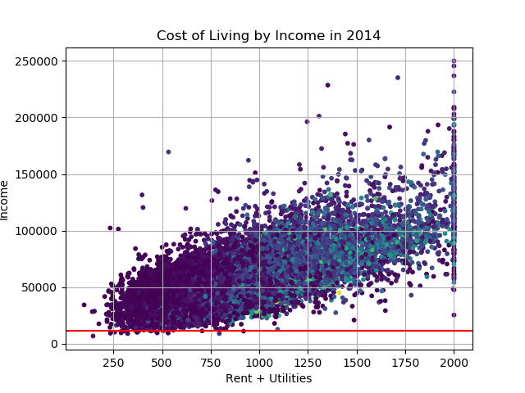
Rent vs. Income 2014
---- = poverty line
= higher population
= lower population
Poverty line = $11,670

Slide 14
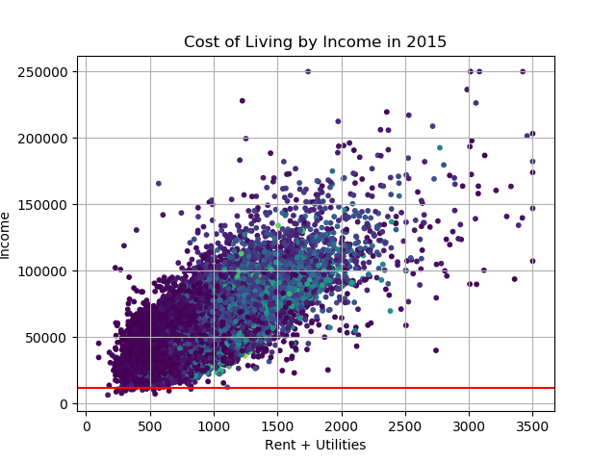
Rent vs. Income 2015
---- = poverty line
= higher population
= lower population
Poverty line = $11,770
Takeaways:
People with more income can afford more in rent and utilities
The US Census data shows a maximum median rent of $2,001 for each year except 2015 - which shows a maximum of $3,501.

Slide 15
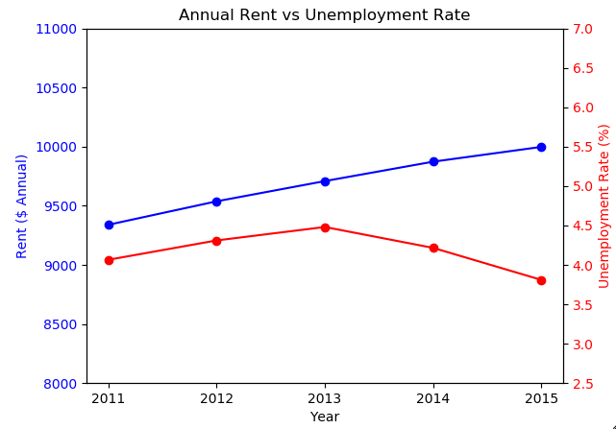
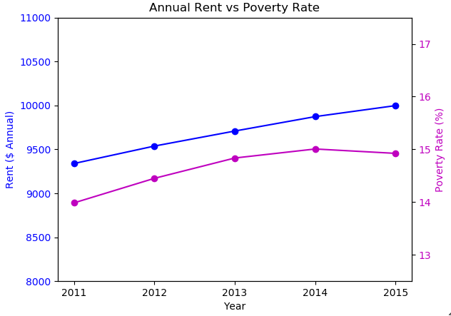
Rent vs Unemployment and Poverty Rates
These graphs compare the relationship of average rent relative to unemployment and poverty rates from 2011 to 2015
Appears to be an inverse relationship of rent vs unemployment and poverty rates in the latter years
Note: National average across all years

Slide 16
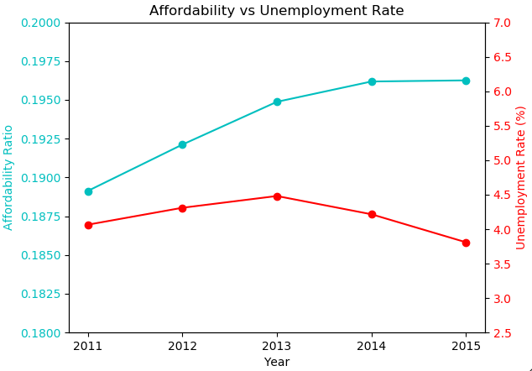
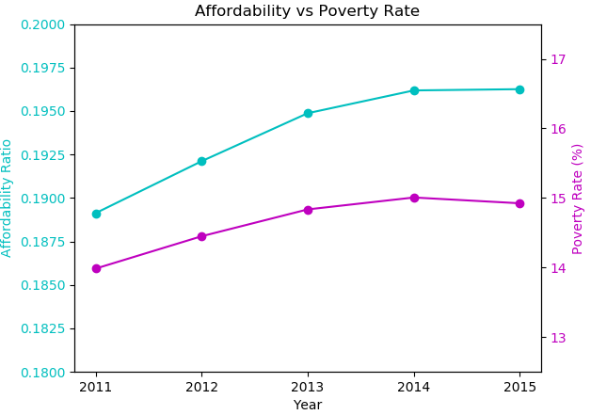
Affordability vs Unemployment and Poverty Rates
These graphs compare the relationship of affordability relative to unemployment and poverty rates from 2011 to 2015
Appears to be a relationship of stabilizing affordability vs declining unemployment and poverty rates in the latter years
Note: Affordability = Rent+Utilities / Household Income; National average across all years

Slide 17
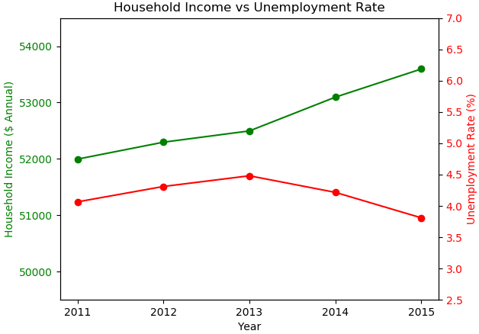
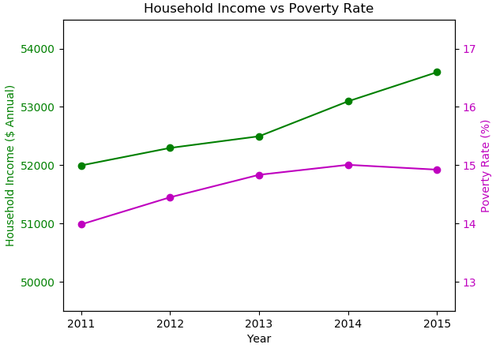
Household Income vs Unemployment and Poverty Rates
These graphs compare the relationship of household income relative to unemployment rate and poverty rate from 2011 to 2015
Appears to be an inverse relationship of household income vs declining unemployment and poverty rates in the latter years
Note: Affordability = Rent+Utilities / Household Income; National average across all years

Slide 18
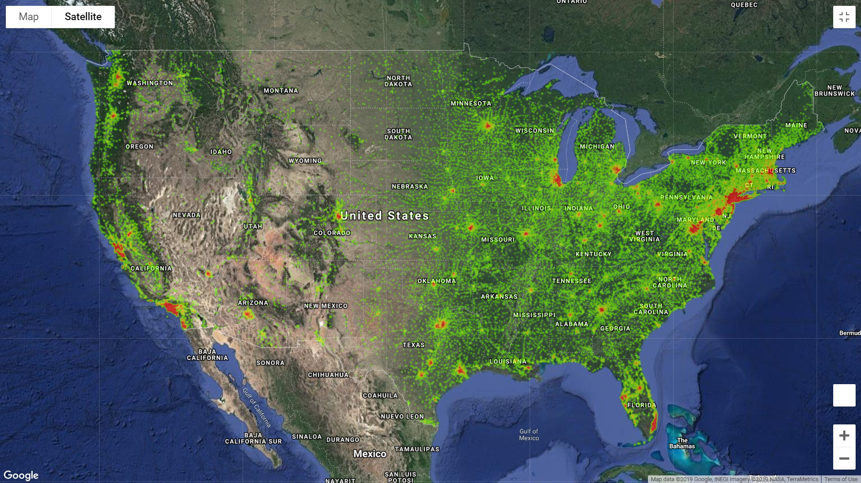
Average Income Heat Map (2011)

Slide 19
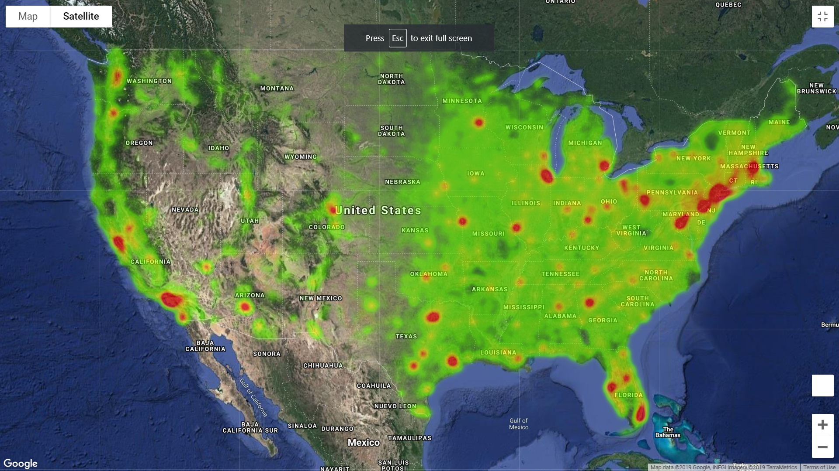
Average Affordability Heat Map (2011)

Slide 20
Post Mortem
Discuss any difficulties that arose, and how you dealt with them: One issue that we found with the Census API was that we were only able to pull data from 2011-2015. This is probably due to the fact that Census data isn’t collected every year. Also, many of the locations we looked at were missing data which caused us to have to exclude numerous cities from our data set.
Discuss any additional questions that came up, but which you didn't have time to answer: What would you research next, if you had two more weeks? If we had more time, I think we would want to dig deeper into specific cities and be able to look at a larger span of time. We would also want to look at more granular areas that might be disproportionately affected by increasing rent and overall cost of living.

Slide 21
Questions?

